Slide 1

Introduction to LangChain

Slide 2

Agenda
Understanding LangChain
Components in LangChain
Benefits of LangChain
Prompt Template
Code WalkThrough

Slide 3
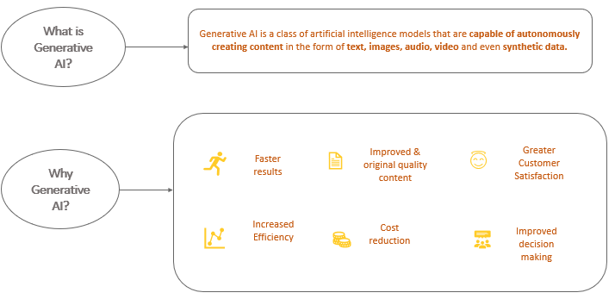
Generative AI

Slide 4
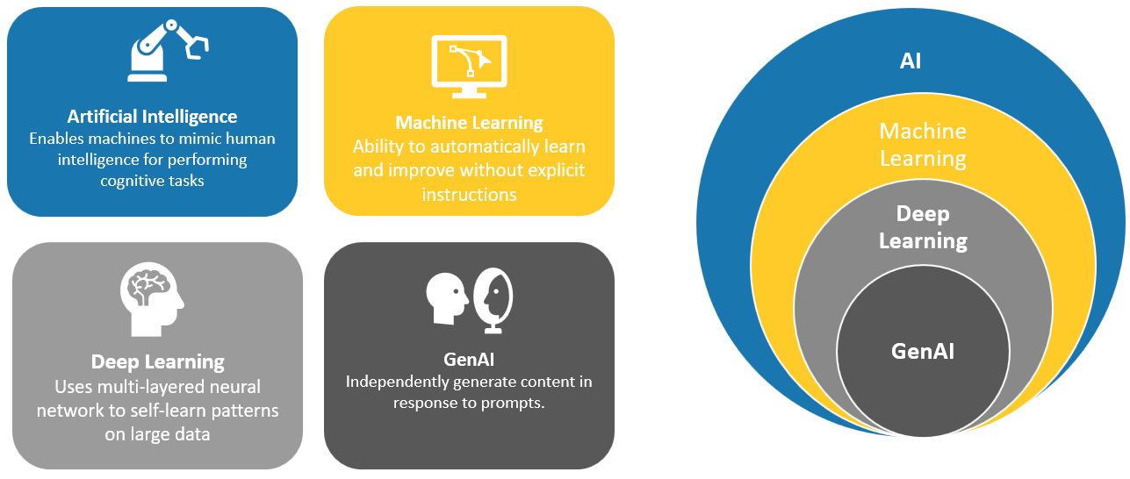
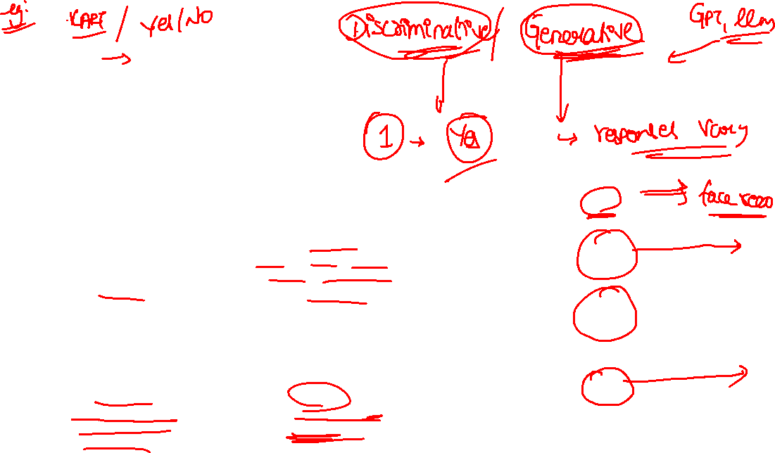
Traditional ML Methods vs GenAI

Slide 5

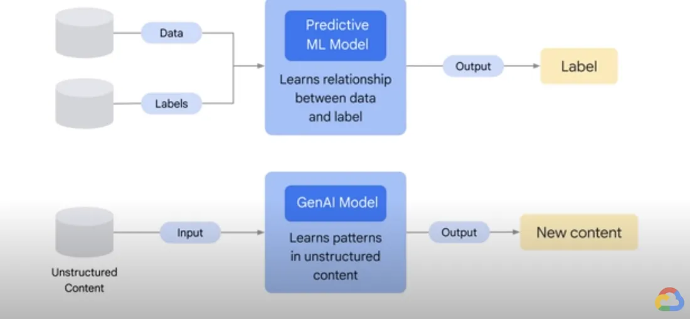


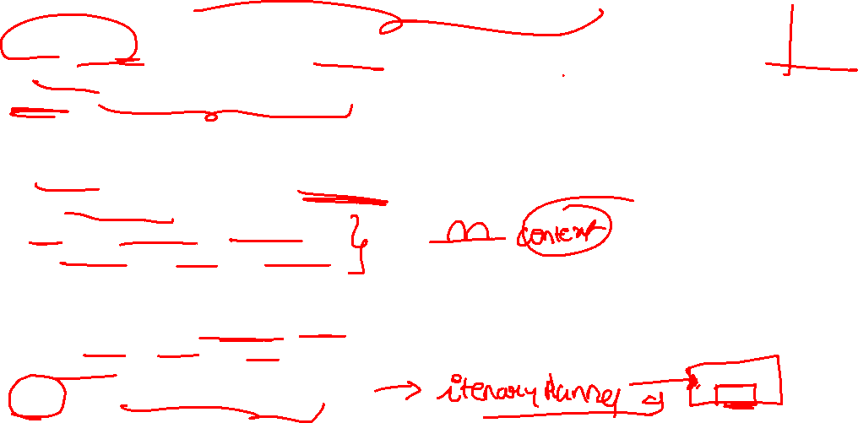
Traditional ML Methods vs GenAI
Traditional ML: understand data & predict or classify
Traditional ML: Recommenders, Virtual Assistants, Segmentation, Speech Recognition
Gen AI: construct content like train data
Traditional ML: Discriminative | Unidirectional | Label & Unlabeled data
Gen AI: Bidirectional - dual-learning | Unlabeled data | Uni-modal | Bi-modal
Gen AI: creative tasks with customization
Source: https://medium.com/google-cloud/google-cloud-skills-boost-part-1-introduction-to-generative-ai-4511ec555814

Slide 6
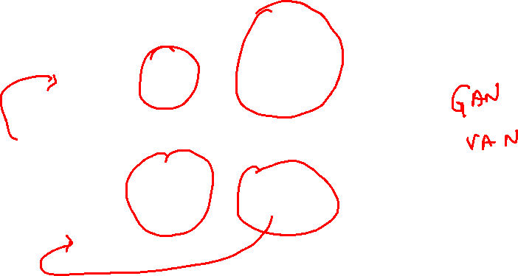
How does GenAI work?
Data Ingestion
Pattern Analysis & learn distribution of input data
Generate new content
Continuous parameters adjust

Slide 7

Building Blocks of GenAI
GANs
Transformers
VAEs
LLMs

Slide 8
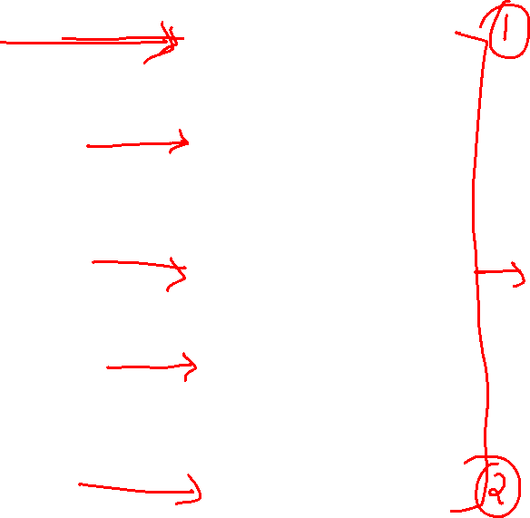
Prompt Engineering
Human Thinks
Human Prompts AI and gives context
Prompt Engineering
AI gives a result
Human builds on the result
Human delivers

Slide 9
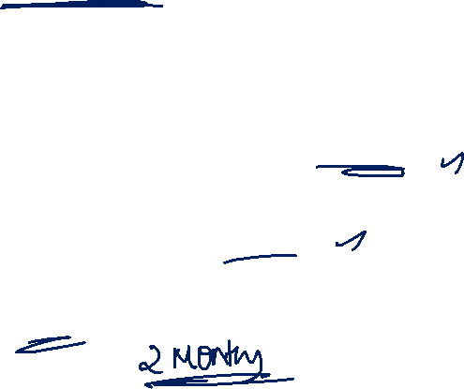
Time taken for 100Million Active Users
Instagram
TikTok
ChatGPT
30 Months
9 Months
2 Months

Slide 10
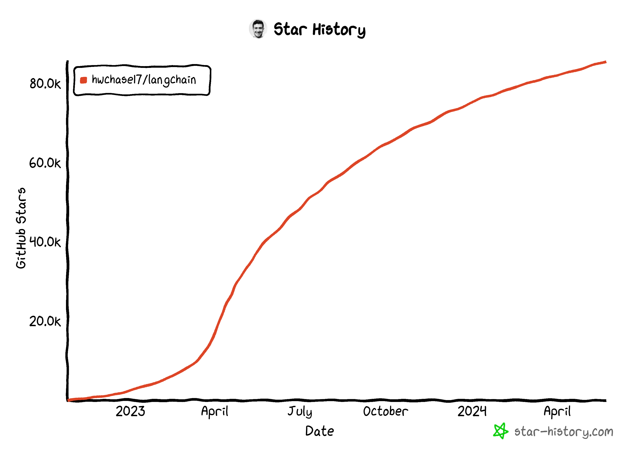
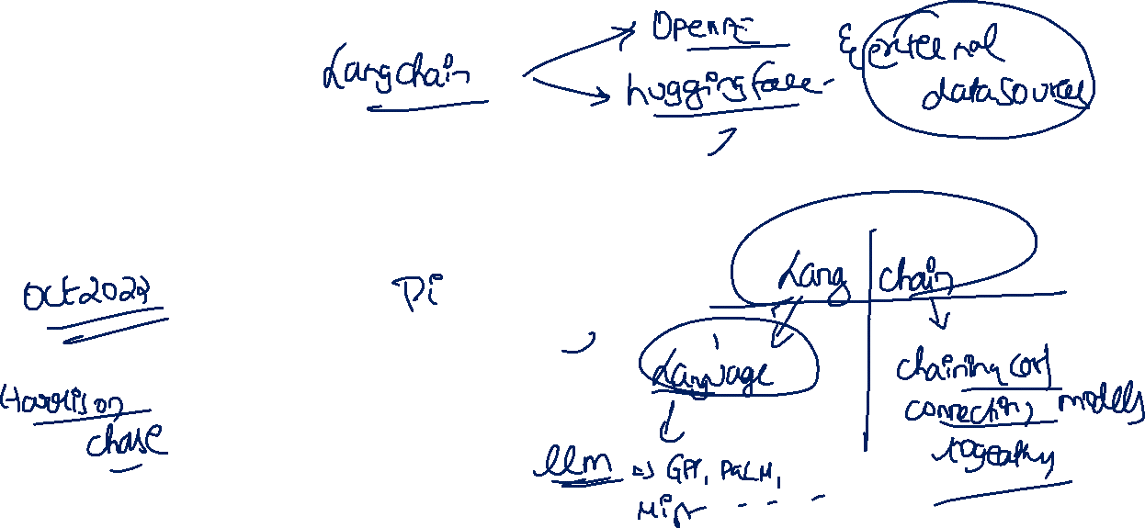
Star History and LangChain GitHub

Slide 11
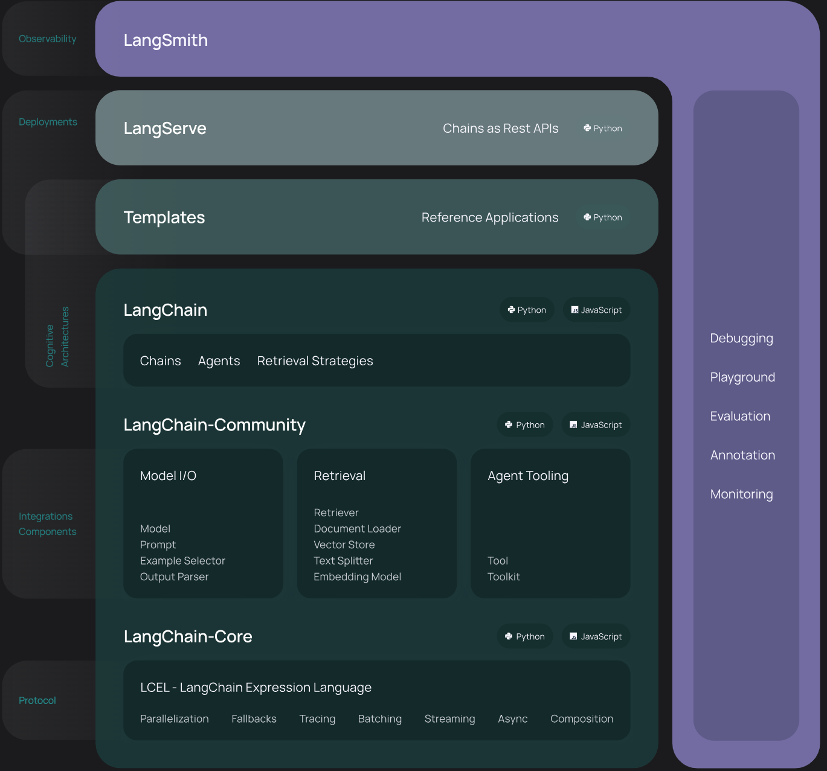

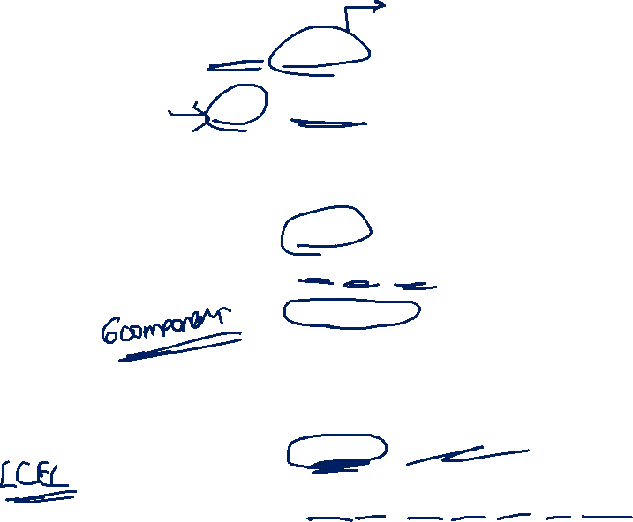
LangChain

Slide 12
LangChain Components
Model I/O
Chains
LangChain Components
Data Connections & Retrieval
Agents
Memory
Callbacks

Slide 13
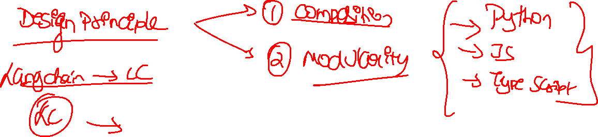

Slide 14





































Slide 15

Applications of LangChain
Chatbots and personal assistants
Text summarization and analysis
Q&A over documents or structured data
Code generation and understanding
Interaction with APIs

Slide 16
Benefits of LangChain
Ease of Use
Flexibility
Scalability
Robustness

Slide 17
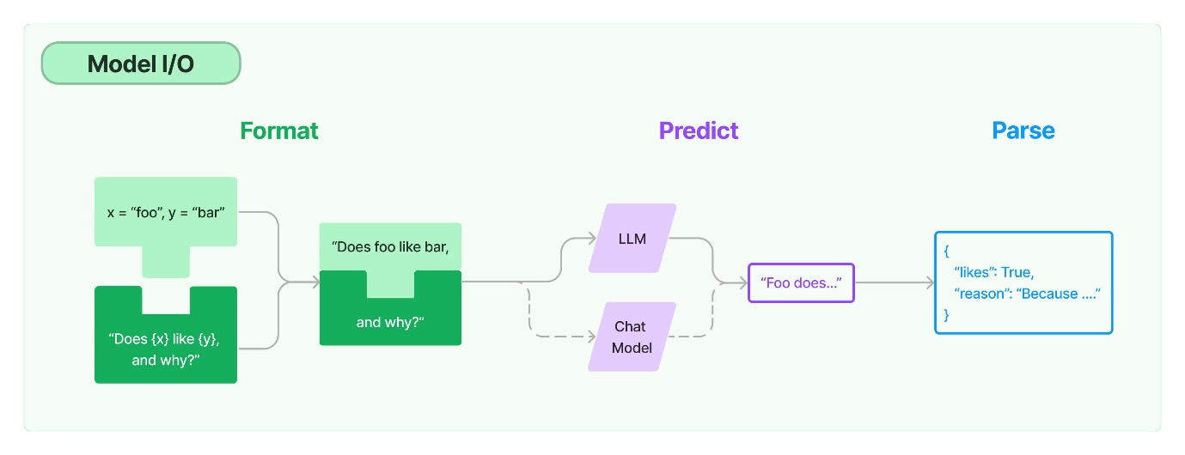
Model I/O

Slide 18
Prompt Template
Prompt
Instruction
Context
User Input
Output Indicator
Elements*

Slide 19
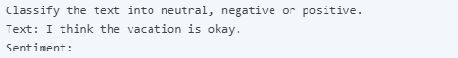
Zero Shot Prompting
Direct request with sufficient context
Prompt
Example
Generated artifact

Slide 20
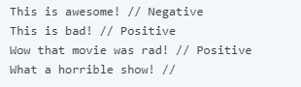
One shot or few shot examples
Task description
Example Input 1
Example Input 2 Prompt
Example
Points to remember
Label Space & Distribution
Format
Random labels
Generated artifact

Slide 21
Chain of Thought Prompt
Process description
Prompt
Other CoT techniques
Zero-shot COT Prompting
Automatic Chain-of-Thought
ReAct
Generated artifact

Slide 22
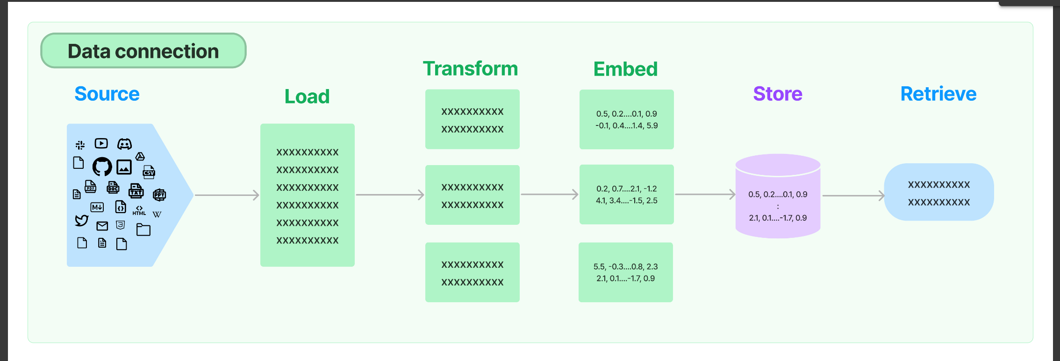









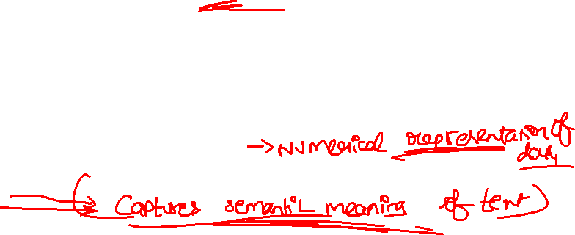











Data Connection

Slide 23
Thank You!

